Slide 1

Medical Laboratory Database System
Presented by:
‏Soha Yehia ‏Omar Hisham
‏Nour Said Haneen Mohamed

Slide 2
Project OVERVIEW
Purpose:
Manage medical laboratory data efficiently.
Includes:
Atients
doctors
Tests
Components
results
Implemented in MySQL

Slide 3
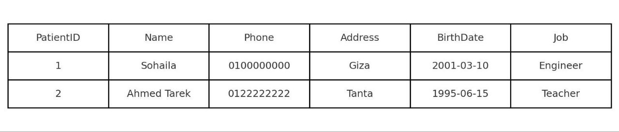
Database Schema
‏- Created MedicalLabDB
Tables:
Patient
Laboratorian
Component
MedicalTest:
‏- Each table includes attributes like name, phone, etc.

Slide 4
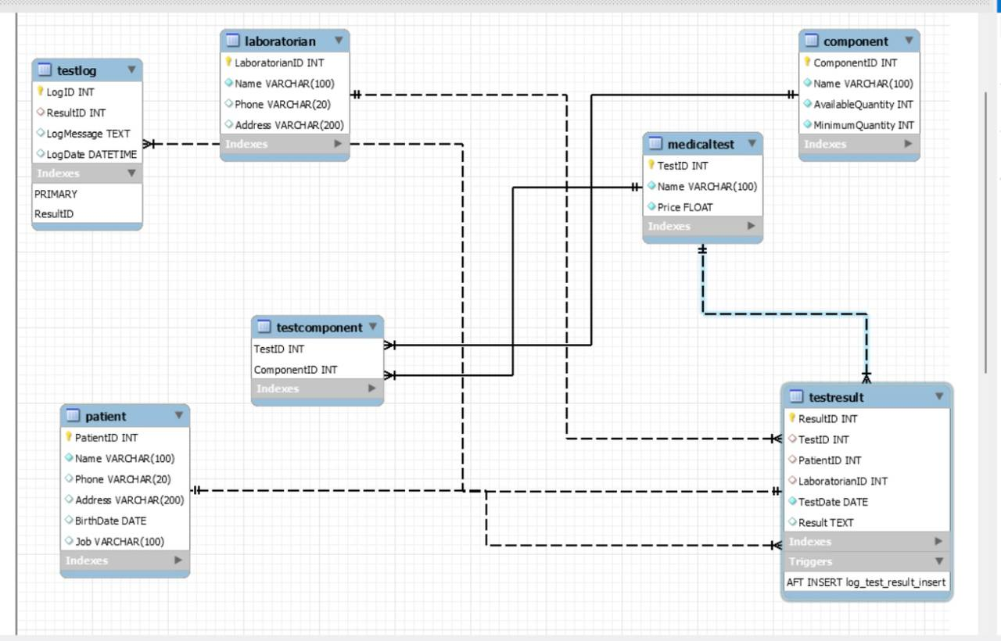
Conceptual Design (ERD)
Six entities:
Patient
Doctor
Test
Component
TestResult
TestComponent
- Relationships shown in ERD
- Many-to-many viaTestComponent

Slide 5
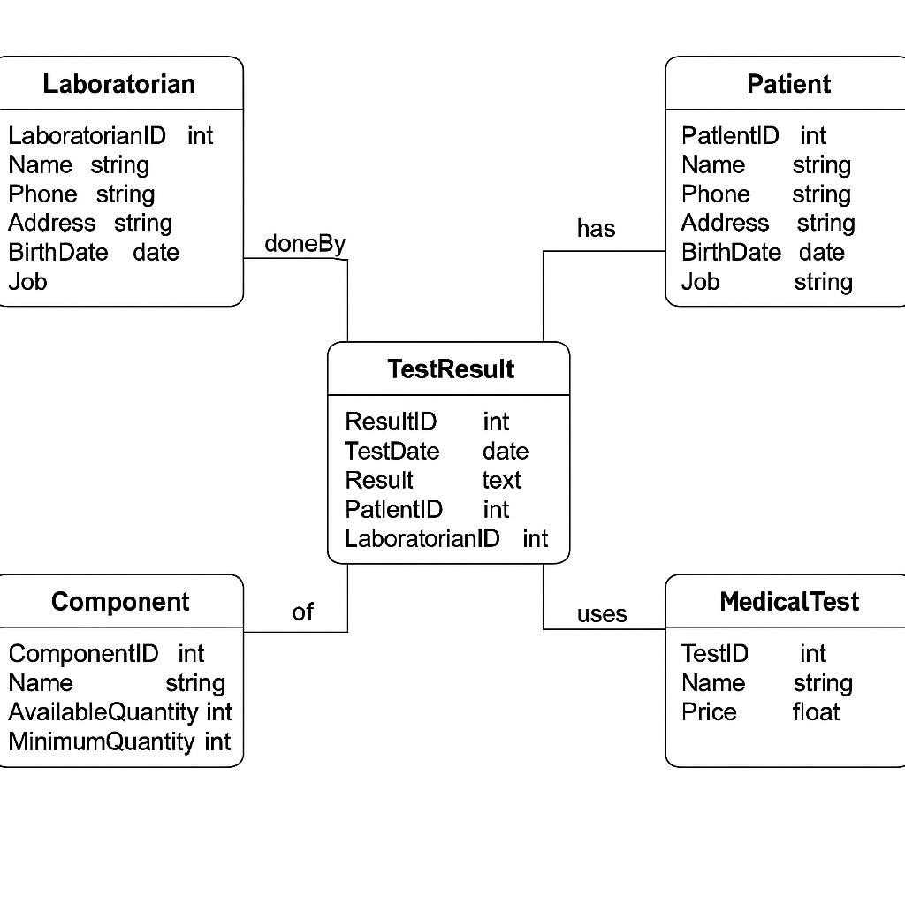
UML Class Diagram
- Classes represent tables
- Attributes = table columns
- Shows system structure in object-oriented way

Slide 6
- TestComponent table: many-to-many handler - TestResult: connects patient, test, doctor - Foreign keys used for integrity
Database Schema

Slide 7
- Added test data: 2 patients, 2 doctors - 3 components, 2 tests - Inserted realistic values and dates
Sample Data

Slide 8
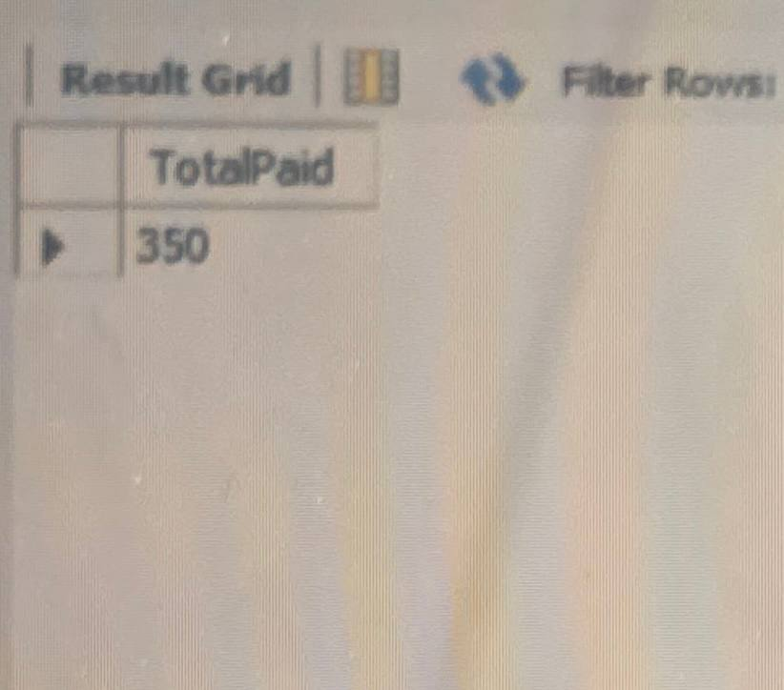
Queries & Results
Query 1:
Query 2:
Query 3:
CBC tests in last year
Low stock components
Total paid by patient

Slide 9
How to Run
Open SQL file in MySQL Workbench
Run script to create tables and data
Use Reverse Engineer for diagram
Run SELECT queries

Slide 10
Tools & Technologies
MySQL Workbench
SQL: DDL + DML + Queries
Diagrams: ERD + UML

Slide 11
Conclusion
Built a full lab database system
Tested with sample data and queries
Ready for real-world use

Slide 12
Conclusion & Final Words
✔️Built a full working database for a medical lab
✔️ Designed with ERD and UML diagrams
✔️ Structured, tested, and query-ready
✔️ Simple to understand and extend
✔️ Completed with full documentation

Slide 13
Thank you!

